Slide 1
Introduction to the Kimball Lifecycle Approach
Samuel OCEN
E MAIL: - samuel.ocen@mmu.ac.ug
samuel.ocen@student.uonbi.ac.ke
MOB: - +256(0)775 679 505
+256(0)706 109 393

Slide 2
Introduction
The Kimball Lifecycle provides the overall framework that ties together the various activities of a DW/BI implementation.
The Kimball Lifecycle methodology first took root at Metaphor Computer Systems in the 1980s. Metaphor was a pioneering decision support vendor; its hardware/software product offering was based on LAN technology with a relational database server and graphical user interface client built on a 32-bit operating system.

Slide 3
Lifecycle history
Over the years, the authors have been involved with literally hundreds of DW/BI projects in a variety of capacities, including vendor, consultant, IT project team member, and business user.

Slide 4
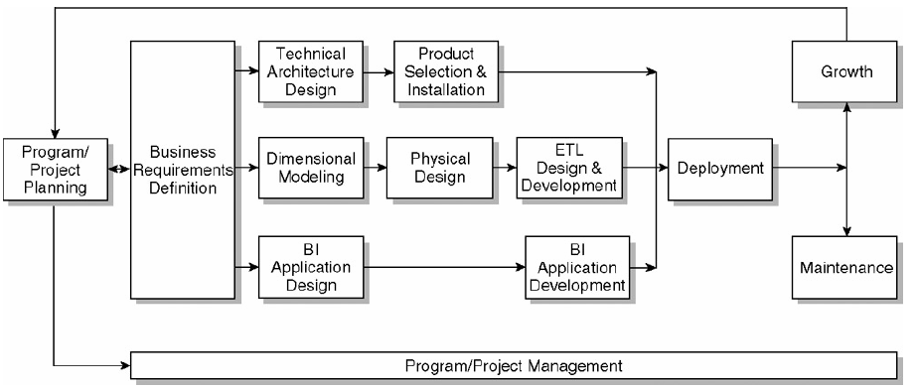
Lifecycle milestone

Slide 5
Program/Project Planning
Project refers to a single iteration of the Kimball Lifecycle from launch through deployment; projects have a finite start and end. On the other hand, program refers to the broader, ongoing coordination of resources, infrastructure, timelines, and communication across multiple projects;
A program is an overall umbrella encompassing more than one project. It should continuously renew itself and should rarely have an abrupt end.

Slide 6
Business Requirements Definition
A DW/BI initiative's likelihood of success is greatly increased by a sound understanding of the business users and their requirements.
Our approach for gathering knowledge workers' analytic requirements differs significantly from more traditional, data-driven requirements analysis.

Slide 7
Technical Architecture Design
DW/BI environments require the integration of numerous technologies. The technical architecture design establishes the overall architectural framework and vision.
Three factors - the business requirements, current technical environment, and planned strategic technical directions must be considered simultaneously to establish the appropriate DW/BI technical architecture design.

Slide 8
Product Selection and Installation
Using your technical architecture plan as a virtual shopping list of needed capabilities, specific architectural components such as the hardware platform, database management system, extract-transformation-load (ETL) tool, or data access query and reporting tool must be evaluated and selected.

Slide 9
Data Track
The second parallel set of activities following the business requirements definition is the data track, from the design of the target dimensional model, to the physical instantiation of the model, and finally the "heavy lifting" where source data is extracted, transformed, and loaded into the target models.

Slide 10
Dimensional Modeling
During the gathering of business requirements, the organization's data needs are determined and documented in a preliminary enterprise data warehouse bus matrix representing the organization's key business processes and their associated dimensionality.
Dimensional Modeling During the gathering of business requirements, the organization's data needs are determined and documented in a preliminary enterprise data warehouse bus matrix representing the organization's key business processes and their associated dimensionality.

Slide 11
Physical Design
Physical database design focuses on defining the physical structures, including setting up the database environment and instituting appropriate security.
ETL Design and Development
Design and development of the extract, transformation, and load (ETL) system remains one of the most vexing challenges confronted by a DW/BI project team; even when all the other tasks have been well planned and executed, 70% of the risk and effort in the DW/BI project comes from this step.

Slide 12
BI Application Design
Immediately following the business requirements definition, while some DW/BI team members are working on the technical architecture and dimensional models, others should be working with the business to identify the candidate BI applications, along with appropriate navigation interfaces to address the users' needs and capabilities.
BI Application Development
Following BI application specification, application development tasks include configuring the business metadata and tool infrastructure, and then constructing and validating the specified analytic and operational BI applications, along with the navigational portal

Slide 13
Deployment
The three parallel tracks, focused on technology, data, and BI applications, converge at deployment. Extensive planning is required to ensure that these puzzle pieces are tested and fit together properly, in conjunction with the appropriate education and support infrastructure.
Maintenance
Once the DW/BI system is in production, technical operational tasks are necessary to keep the system performing optimally, including usage monitoring, performance tuning, index maintenance, and system backup.
Growth
If you have done your job well, the DW/BI system is bound to expand and evolve to deliver more value to the business. Unlike traditional systems development initiatives, change should be viewed as a sign of success, not failure. Prioritization processes must be established to deal with the ongoing business demand.

Slide 14
Using lifecycle roadmap
It identifies task sequencing and highlights the activities that should happen concurrently throughout the technology, data, and BI application tracks.
The resources and time require, as with most approaches, you may need to customize the Kimball Lifecycle to address the unique needs of your organizations needs for each Lifecycle box are not equal.

Slide 15
Lifecycle vocabulary
Data warehousing.
The overall process of providing information to support business decision making
Business Intelligence.
These refers to the reporting and analysis of data stored in the warehouse.
Enterprise Data Warehouse
These refers to the queryable data in your DW/BI system.
The data warehouse is the foundation for business intelligence.

Slide 16
ETL System
This refer to the extract, transformation, and load (ETL) system as the back room kitchen of the DW/BI environment.

